Slide 1




Customer Data Management And Analysis
1/11/2024

Slide 2
Team Mambare's
Abdulrahman Yehia
Data Analysis using Python
Data visualization using Power BI
Naglaa Ali
Data Warehouse using SSIS
Mena Sami
Data Analysis Using SQL
Yasmin Ali
ML Modeling
Create Stored procedures and triggers
Create and Design Database using SSMS
Create data pipeline and analysis using SQL on Azure
Create Flask App
Presentation
presentation

Slide 3
IDEA:
Global Gourmet is an international food distribution company that specializes in delivering gourmet ingredients and products to various regions. The company operates through multiple departments, each handling different aspects of the business such as sales, logistics, and customer management. The company is known for its high-quality products, efficient order processing, and a strong network of suppliers and shippers worldwide.
Global Gourmet's operational data is stored in a relational database, consisting of several tables that represent the core business processes, including orders, products, suppliers, employees, and more. This document outlines the database structure, describing each table, its columns, and the relationships between them.

Slide 4

AIM:
Develop a robust database architecture for storing company data. Using SSMS
Create DW Using SSIS
Perform exploratory data analysis (EDA) and derive key performance indicators (KPIs).
Provide actionable business insights through analysis and reporting.
Create data pipeline and using Synapse analysis on Azur
Create Flask App to controls the database
Answer critical business questions using Python
ML Model
Visualize the results using Python and Power BI.

Slide 5

Description of the Database Architecture
Our database utilizes a relational database architecture within SQL Server Management Studio (SSMS), optimized for organizing structured data across tables with defined relationships. The relational structure supports data integrity and efficient querying through primary and foreign key constraints, ideal for structured analytics and reporting.

Slide 6

Key Entities and Relationships Between Data Points

Slide 7
1- Customers
Stores customer information.
Primary Key:
CustomerID
Relationships:
Linked to Orders by CustomerID

Slide 8
2- Employees
Contains employee information, including details on which employees manage orders.
Primary Key:
EmployeeID
Relationships:
Linked to Orders through EmployeeID. Also linked to Territories through the EmployeeTerritories table.

Slide 9
3-Categories
Defines product categories.
Primary Key:
CategoryID
Relationships:
Linked to Products by CategoryIDble.

Slide 10
4-Products:
Holds information about products offered by Global Gourmet.
Primary Key:
ProductID
Relationships:
Linked Categories by CategoryID, Suppliers by SupplierID, and OrderDetails by ProductID..

Slide 11
5-Suppliers:
Contains supplier information for each product.
Primary Key:
SupplierID
Relationships:
Linked to Products through SupplierID

Slide 12
6-Shippers:
Contains details of shipping companies used to fulfill orders.
Primary Key:
ShipperID
Relationships:
Linked to Orders by ShipperID.

Slide 13
7-Orders:
Holds order details, such as order dates and shipping information.
Primary Key:
OrderID
Relationships:
Linked Customers through CustomerID, Employees through EmployeeID, Shippers through ShipperID, and OrderDetails by OrderID.

Slide 14
8-OrderDetails:
Stores details of each product in an order, including quantity, unit price, and discounts.
Primary Key:
Composite key of OrderID and ProductID
Relationships:
Linked to Orders by OrderID and Products by ProductID..

Slide 15
9-Territories:
Defines geographic areas where the company operates.
Primary Key:
TerritoryID
Relationships:
Linked to Regions through RegionID and Employees through EmployeeTerritories...

Slide 16
10-Regions:
Contains information about different geographical regions.
Primary Key:
RegionID
Relationships:
Linked to Territories through RegionID.

Slide 17
11-EmployeeTerritories:
Associate's employees with the territories they are responsible for.
Primary Key:
Composite key of EmployeeID and TerritoryID
Relationships:
inked to Employees through EmployeeID and Territories through TerritoryID.

Slide 18

Data Flow (Collection, Storage, and Access)
Collection: Data is sourced from Kaggle CSV files. It is transformed and cleaned before being imported to align with the relational schema.
Storage: CSV files are ingested into SQL Server tables, with SSIS (SQL Server Integration Services) handling ETL processes, data integration, and warehousing.
Analysis and Access: SQL queries and Python scripts are used for exploratory and in-depth analysis. SQL-based analytics help in immediate insights, while Python (with libraries such as Pandas and Scikit-learn) powers advanced analytics and machine learning models for predictive tasks, such as customer churn prediction. Access to data for analysis is streamlined through SQLAlchemy in your Flask app, while Azure Databricks supports data warehousing and larger-scale processing.

Slide 19

Programming Languages
Python: Used for data analysis, machine learning models, and backend development within the Flask application.
JavaScript: Powers interactive elements and dynamic features in the frontend, including data visualizations and form validations.
SQL: Essential for managing and querying the relational database in SQL Server Management Studio (SSMS).

Slide 20
Frameworks/Tools:
Flask: A lightweight Python web framework, serving as the main backend for your web application.
Bootstrap: Used in the frontend to create responsive and visually appealing designs, ensuring consistency across devices.
SQLAlchemy: Manages database connections and ORM (Object Relational Mapping) in Flask, simplifying data interactions with SQL Server.
SSIS (SQL Server Integration Services): Used for data warehousing, ETL processes, and data integration within SQL Server.

Slide 21

Supporting Technologies:
Azure Cloud Platform: Hosts data and provides Azure Data Lake Gen 2, Databricks, and Synapse Analytics for scalable data processing and storage.
Azure Data Studio and Azure Machine Learning: Used for advanced data analysis, visualization, and building machine learning models.

Slide 22
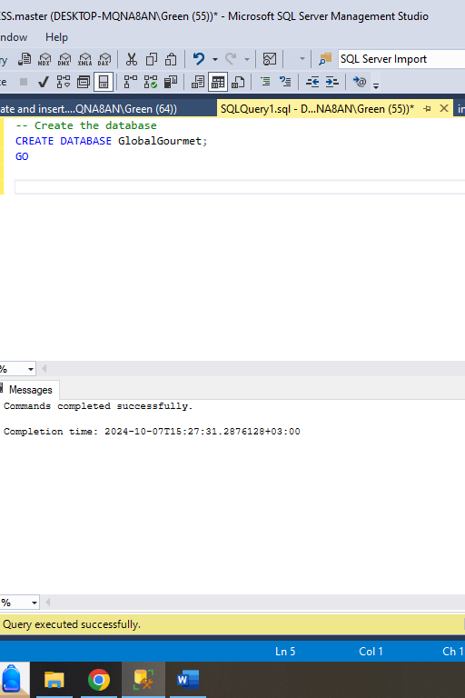
Database Creation
The project began by setting up the Global Gourmet database, created using SQL Server and Windows authentication. The schema consists of the following tables:
- Employees: Information about the employees of Global Gourmet. - Categories: Product categories. - Customers: Information about the company’s customers. - Shippers: Shipping details for product delivery. - Suppliers: Supplier information for sourcing products. - Orders: Details of customer orders. - Products: Information about the products available for sale. - Order Details: Detailed breakdown of each order. - Territories: Regional areas covered by the company. - Employee Territories: Assignment of employees to territories. - Regions: Geographical information for broader market analysis.

Slide 23
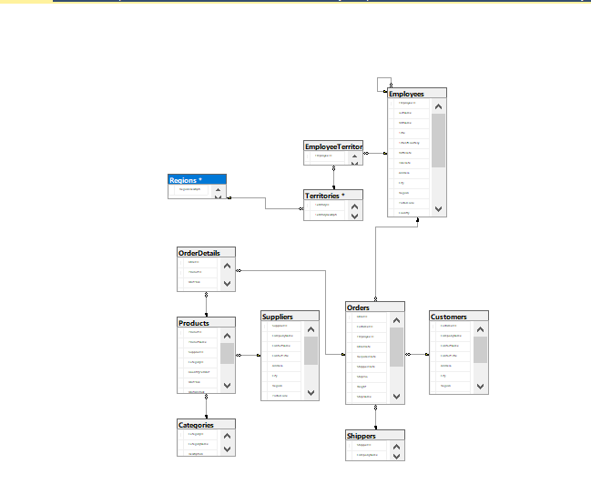
ERD:

Slide 24
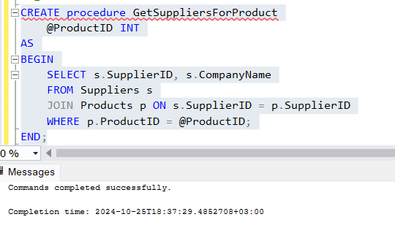
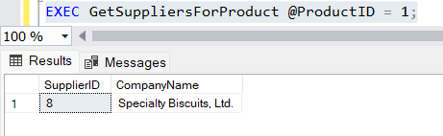
Stored Procedure:
Get Suppliers for a Product

Slide 25
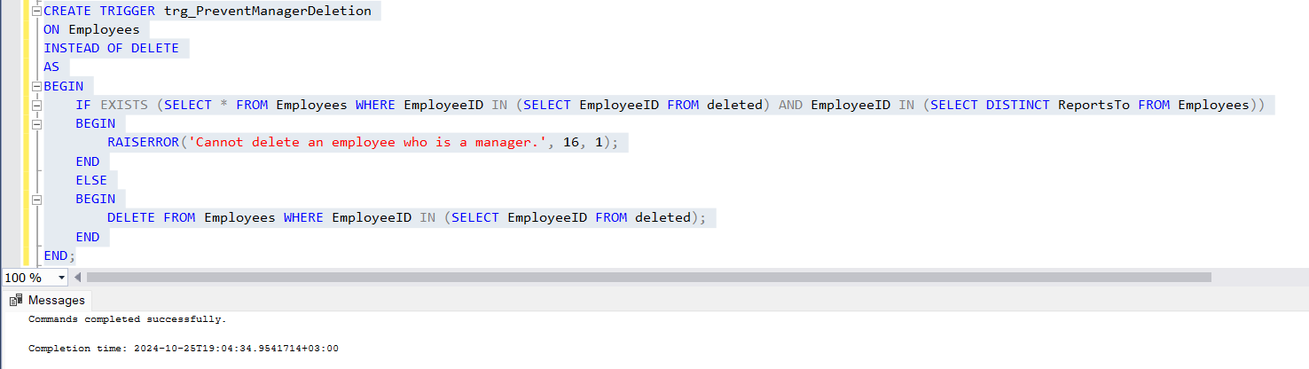
Triggers
trigger for Preventing Deletion of Managers: This trigger prevents the deletion of employees who are manager

Slide 26
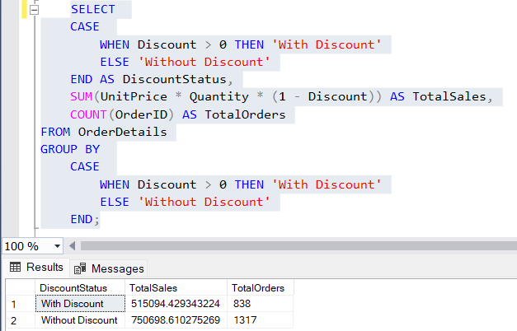
Data Analysis Using SQL
Sales Analysis by Discount Status
This query Shows how discounts impact total sales and order volume.

Slide 27
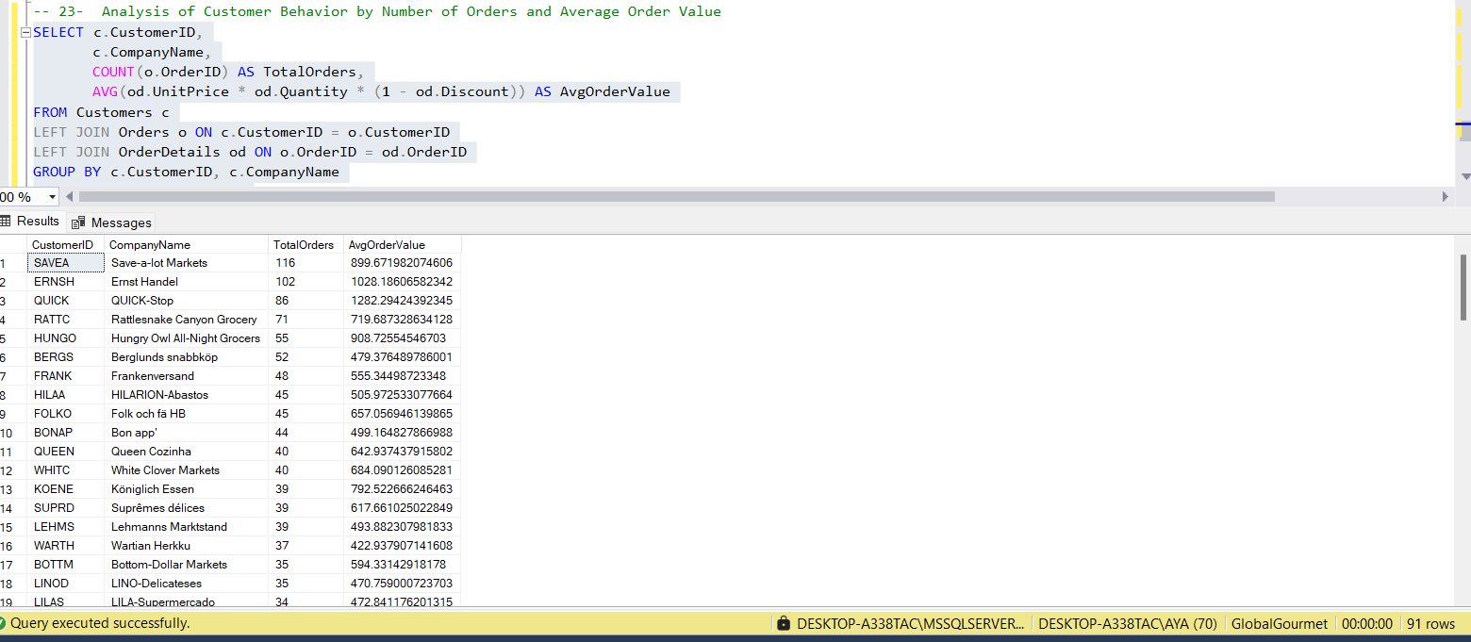
Data Analysis Using SQL
Analysis of Customer Behavior by Number of Orders and Average Order Value
- this query is for analyzing customer behavior in relation to their ordering patterns and average spending.

Slide 28
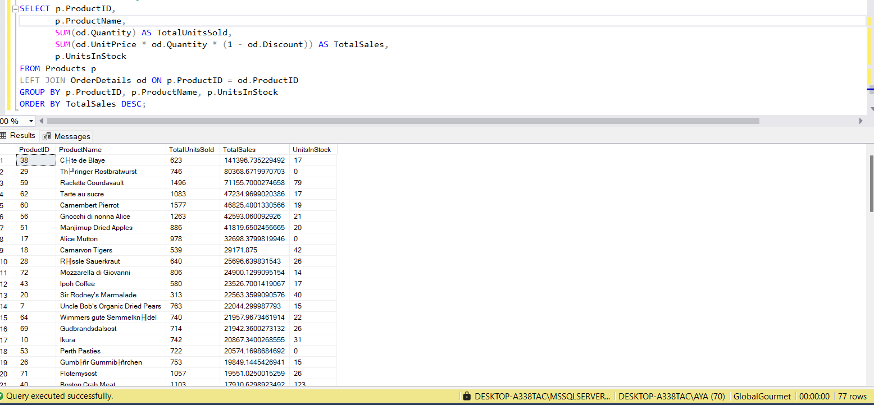
Data Analysis Using SQL
Product Sales Analysis:
-This query analyzes product sales to understand performance and support business planning.

Slide 29
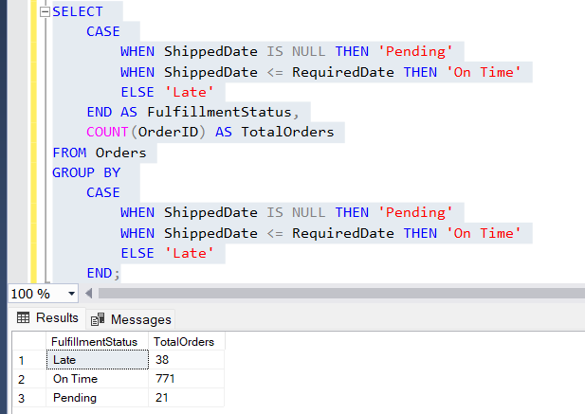
Data Analysis Using SQL
Order Fulfillment Status Analysis: Tracking Pending, On Time, and Late Orders:
- This query helps businesses monitor and improve their order fulfillment processes.

Slide 30
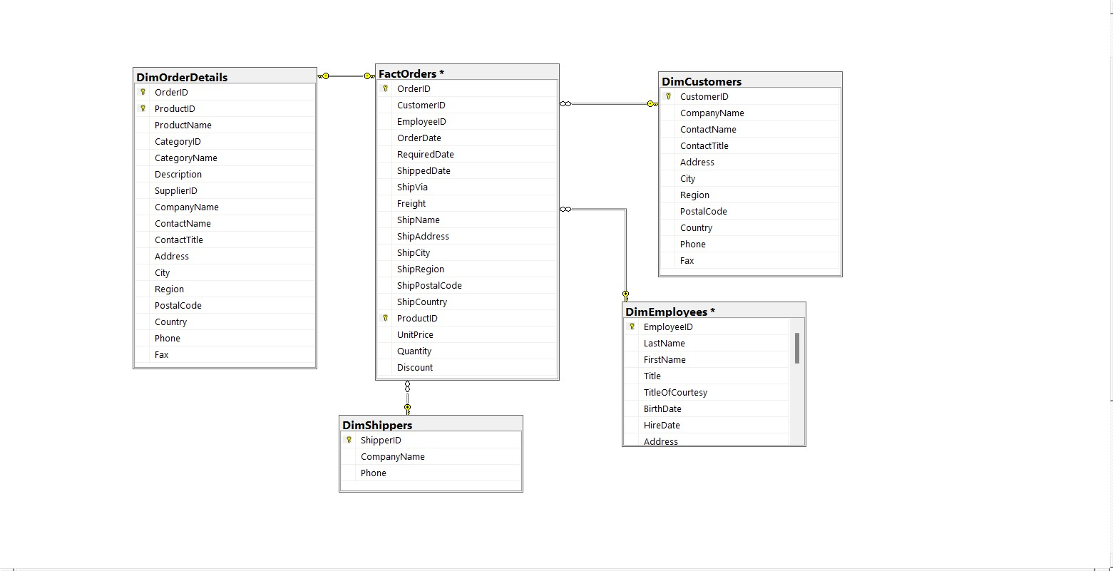
Data Warehouse Design Star schema

Slide 31
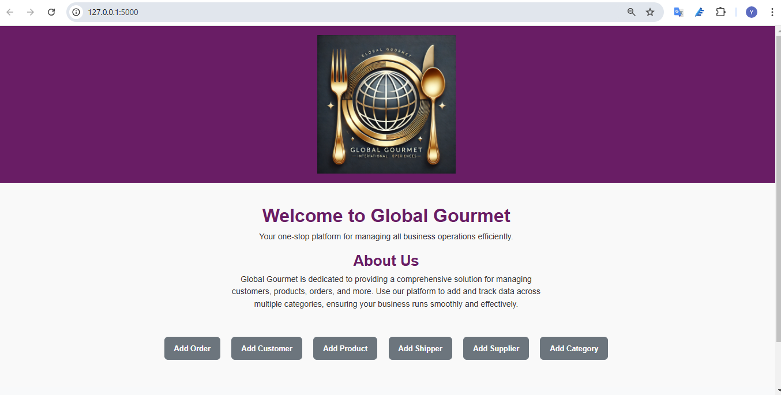
Flask App :

Slide 32
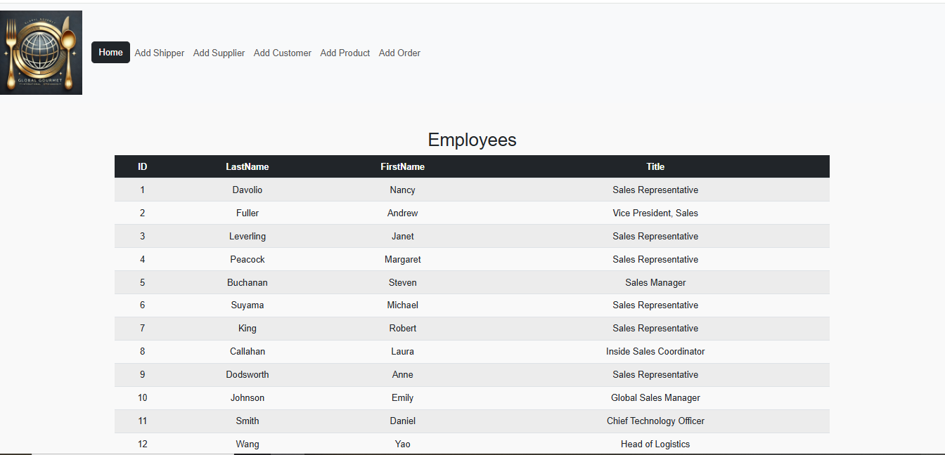
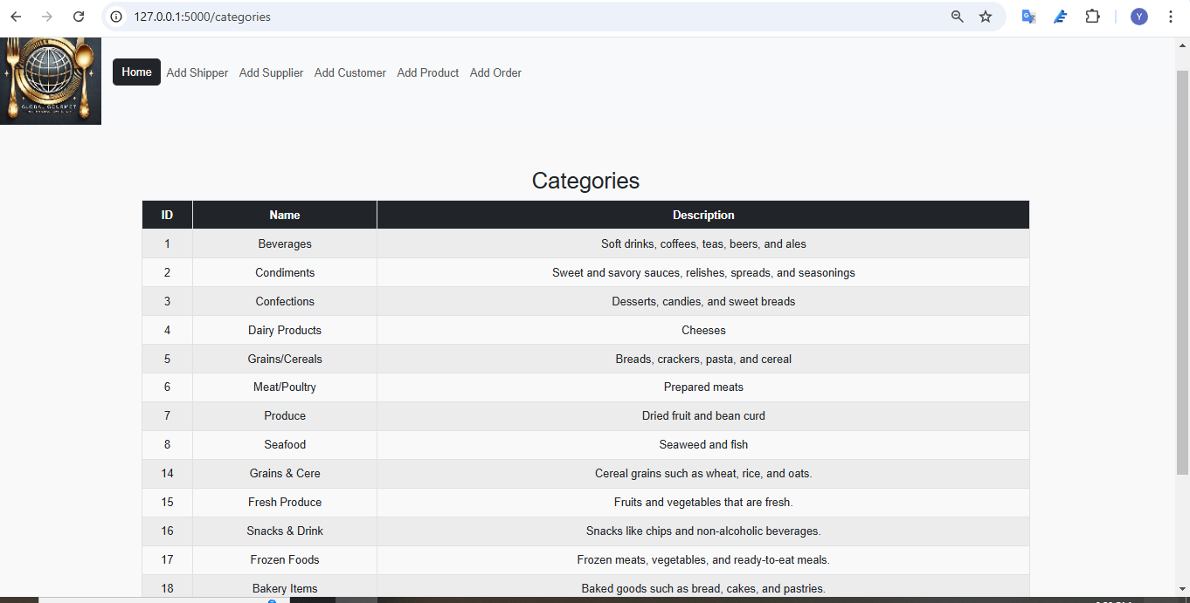
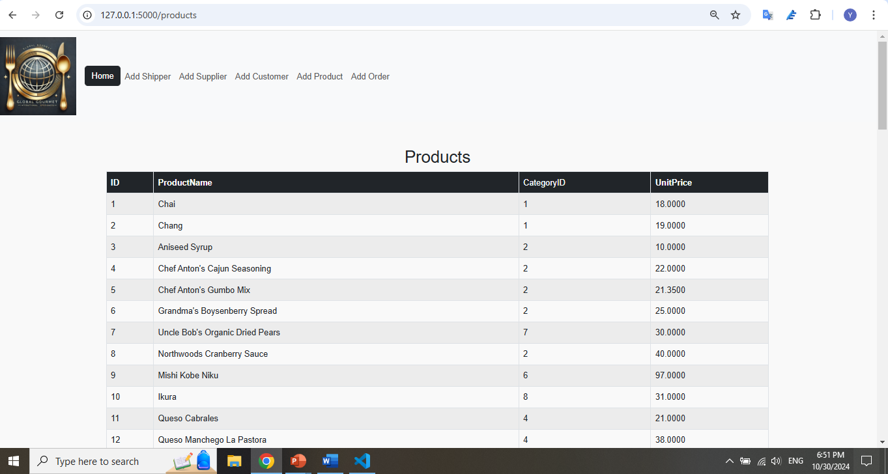
Flask App :Displays Database
Employees
Categories
Products

Slide 33

Flask App :

Slide 34
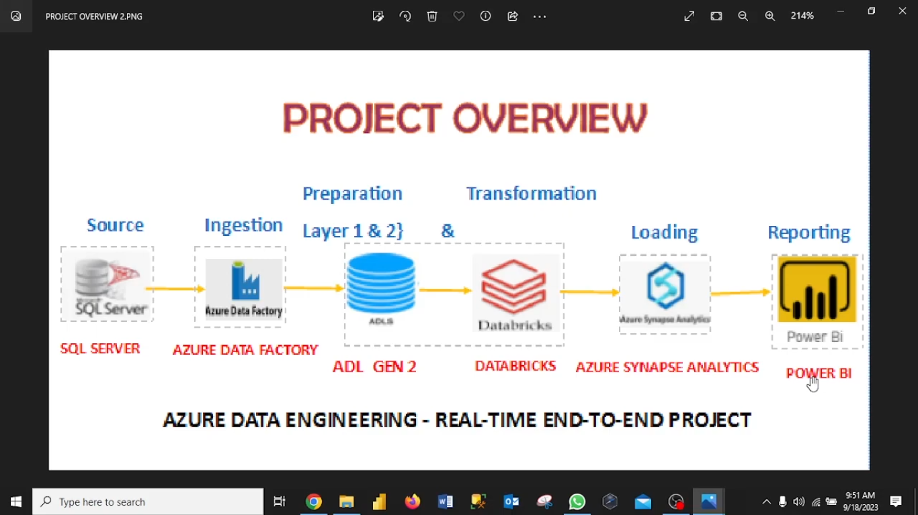
AZURE:

Slide 35
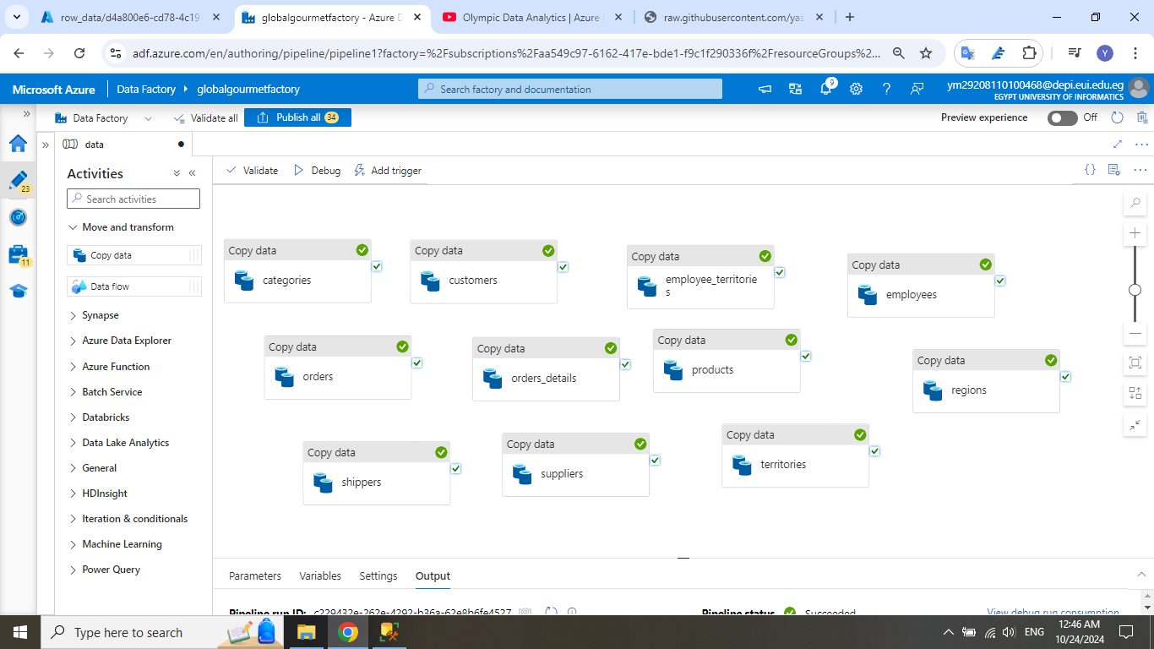
AZURE:
Create new pipeline in Azure Data Factory to upload the CSVs in it

Slide 36
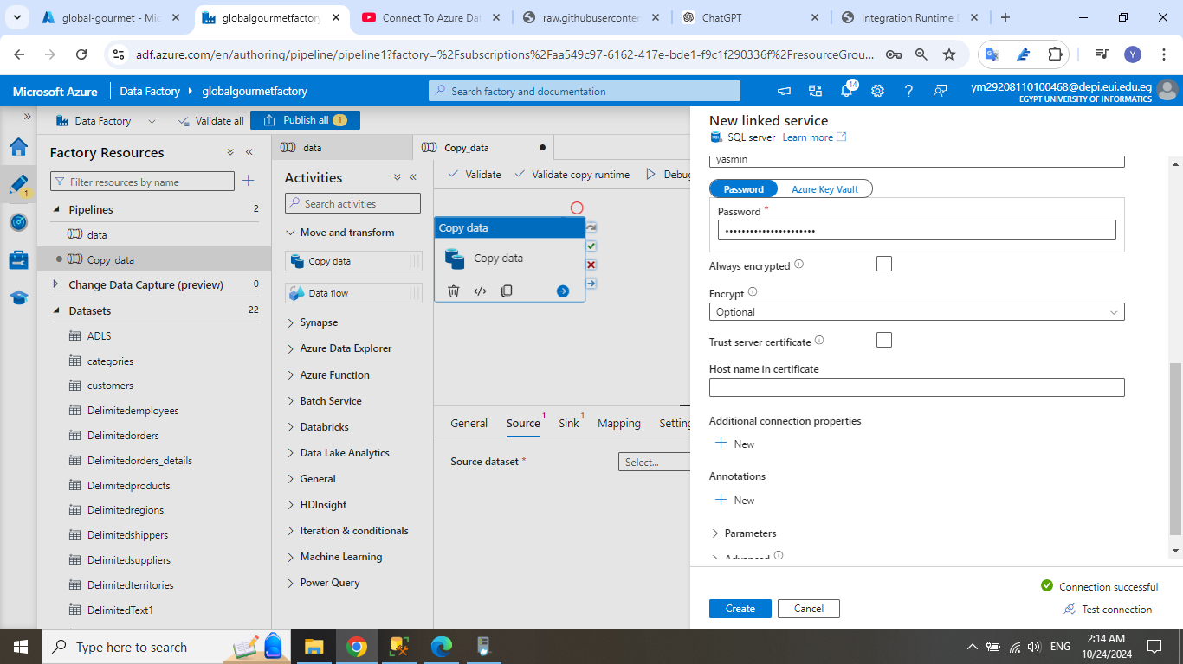
AZURE:
Connect SSMS to Azure

Slide 37

ETL Using Azure Databricks

Slide 38
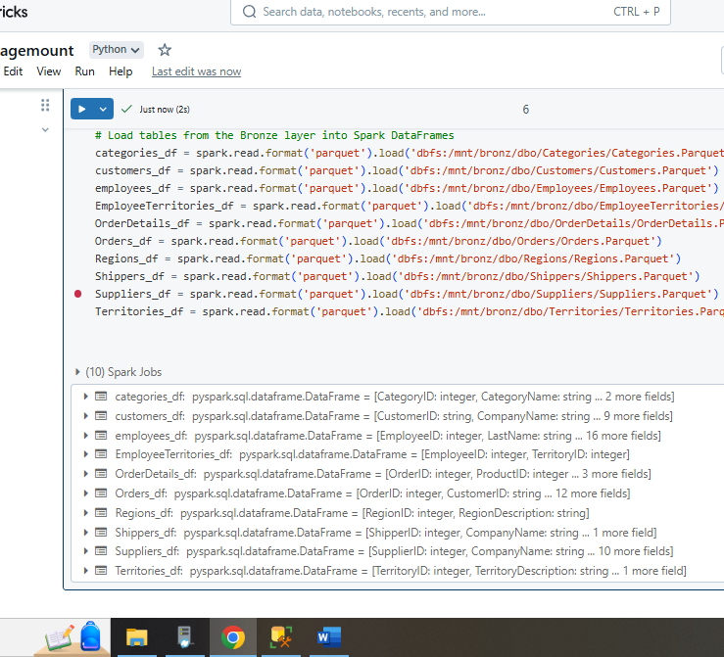
Step 1: Load Data from the Bronze Layer Load each table from the Bronze layer, where data is stored in its raw format as Parquet files.

Slide 39
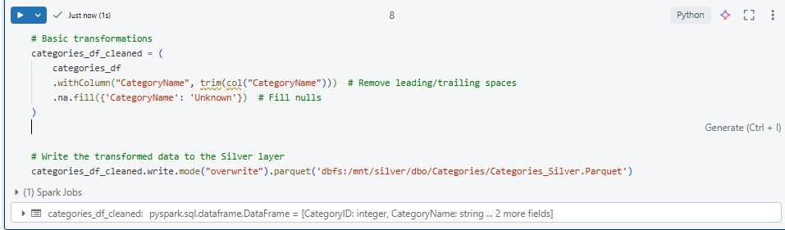
Step 2: Transform and Clean Data in the Silver Layer Apply data cleaning transformations, handle missing values, normalize data types, and prepare the data in a usable format. Save the cleaned data in the Silver layer.

Slide 40
Step 3: Process Remaining Tables to Silver Layer Apply similar data cleaning transformations to the other tables in your Bronze layer. This may include removing duplicates, filling missing values, or joining tables if needed.

Slide 41
Step 4: Create Business-Focused Data in the Gold Layer Aggregate or join data across tables in the Silver layer to create analytics-ready tables in the Gold layer. This step will produce insights, calculations, and metrics for reporting.

Slide 42
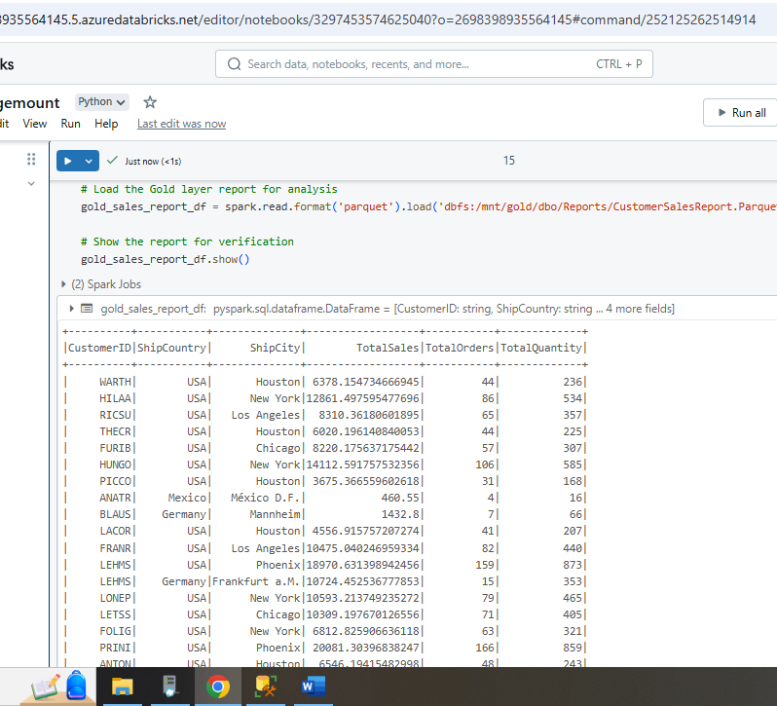
Step 5: Load and Display the Report from the Gold Layer After saving the report, load it for analysis or visualization. .

Slide 43
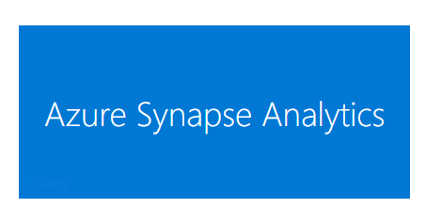

Slide 44
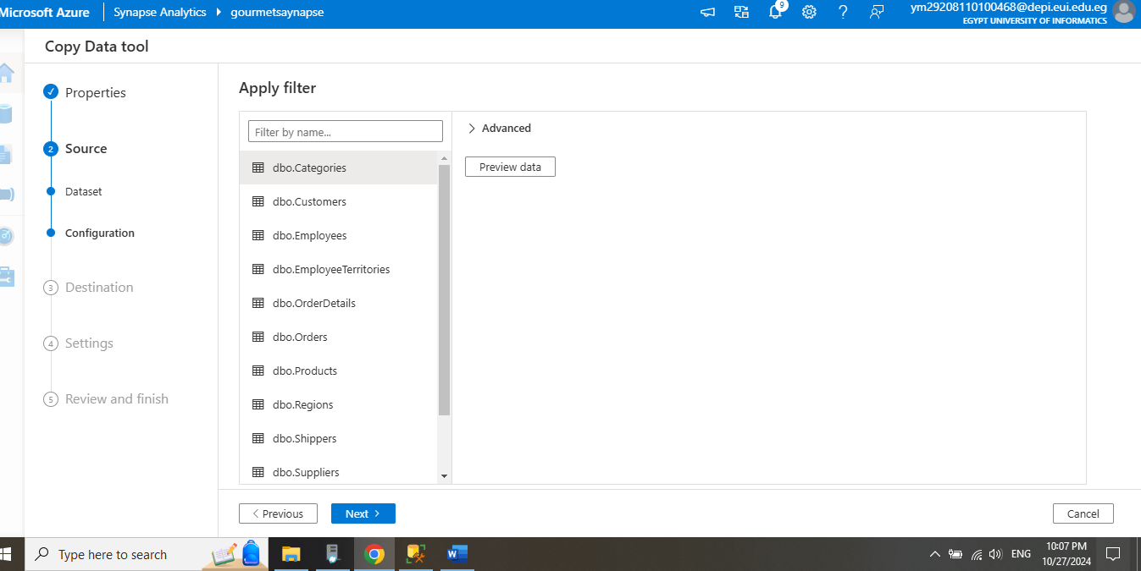
Upload database into synapse analytics.

Slide 45
Create external table So we can start the Analysis

Slide 46
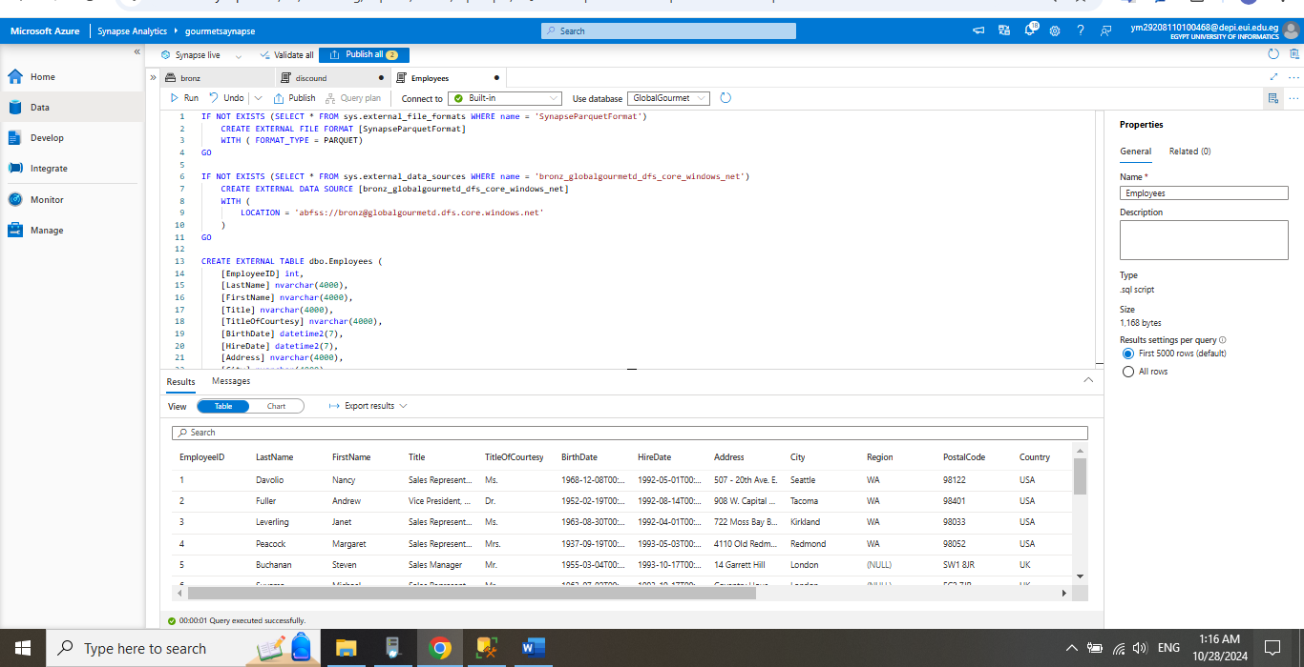
Create external table So we can start the Analysis

Slide 47
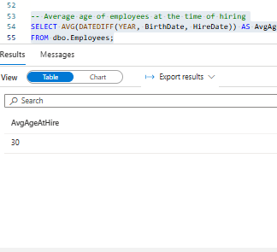
Employees Analysis -- Average age of employees at the time of hiring .

Slide 48
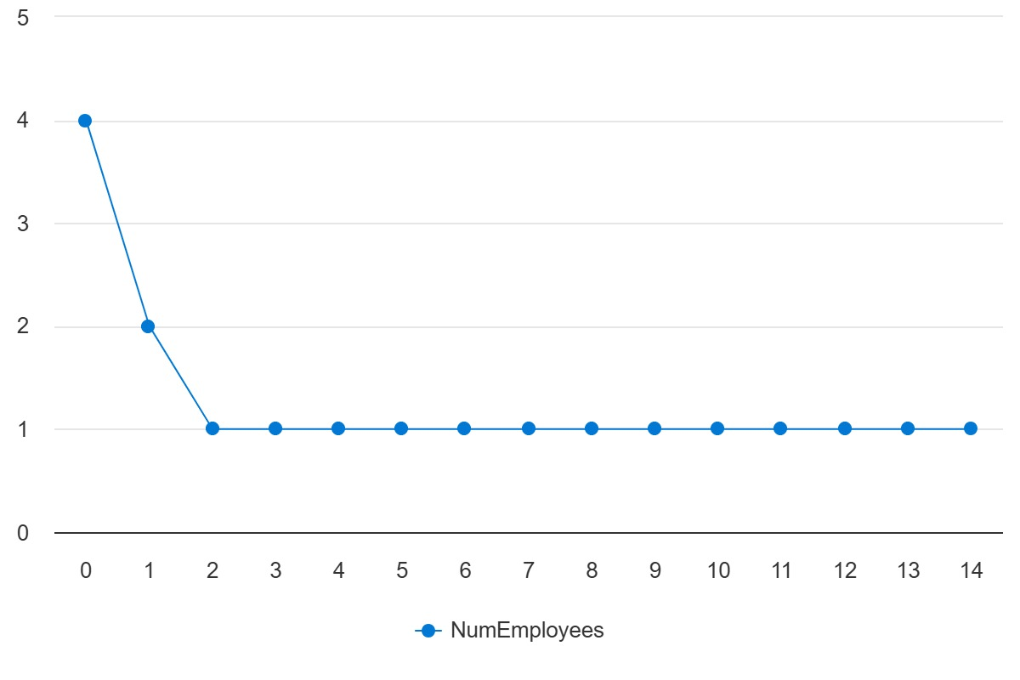
Employees Analysis -- Employees by city .

Slide 49
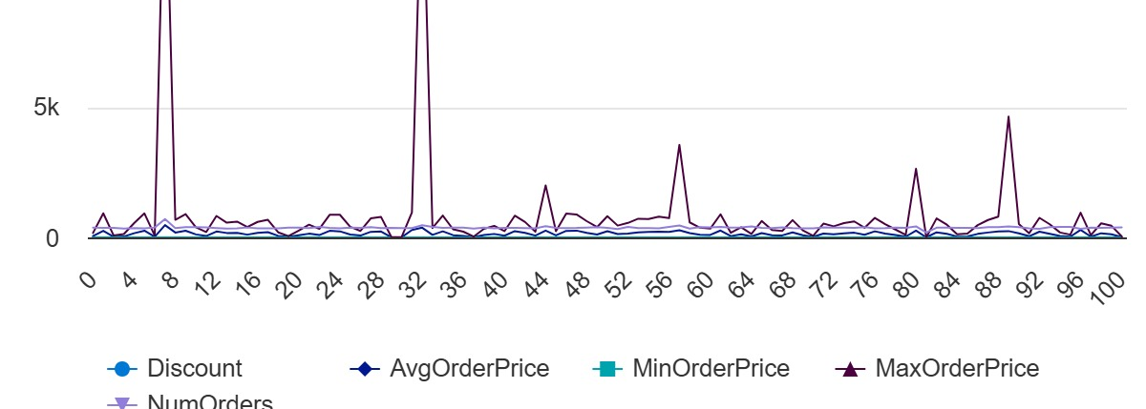
It calculates the average, minimum, and maximum order prices after applying a discount, grouped by each discount level .

Slide 50
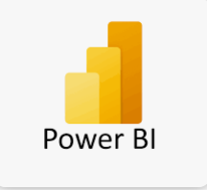
Data Analysis Using Power Bi:

Slide 51
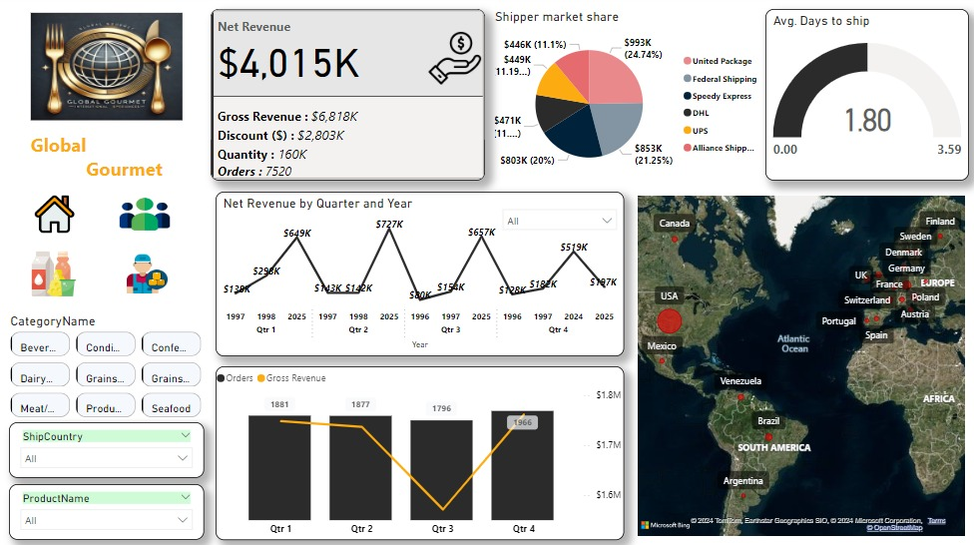

Slide 52
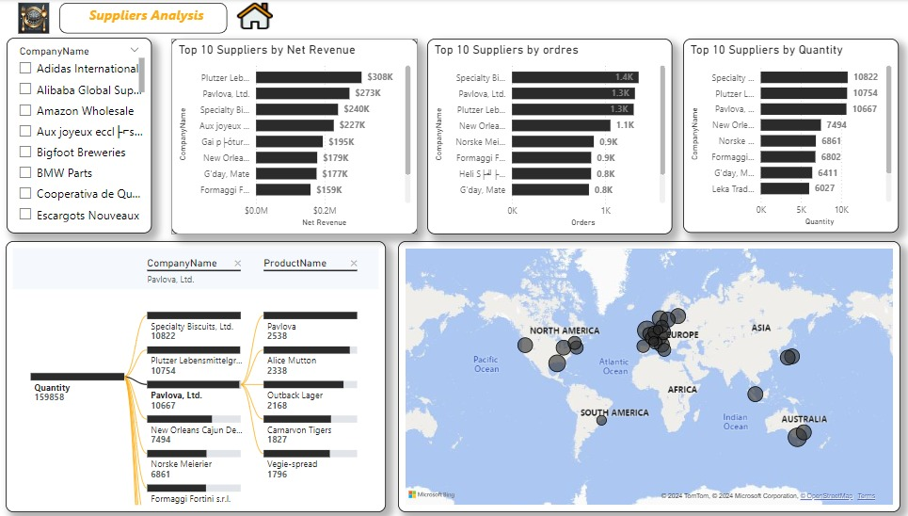

Slide 53
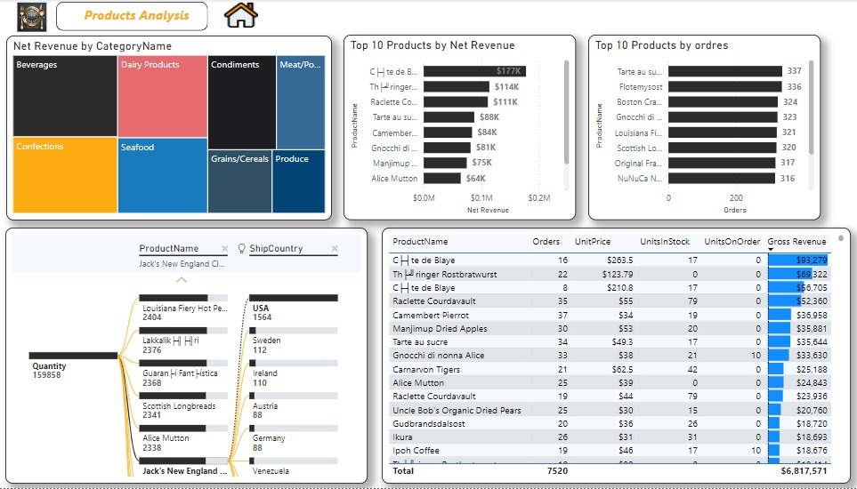

Slide 54
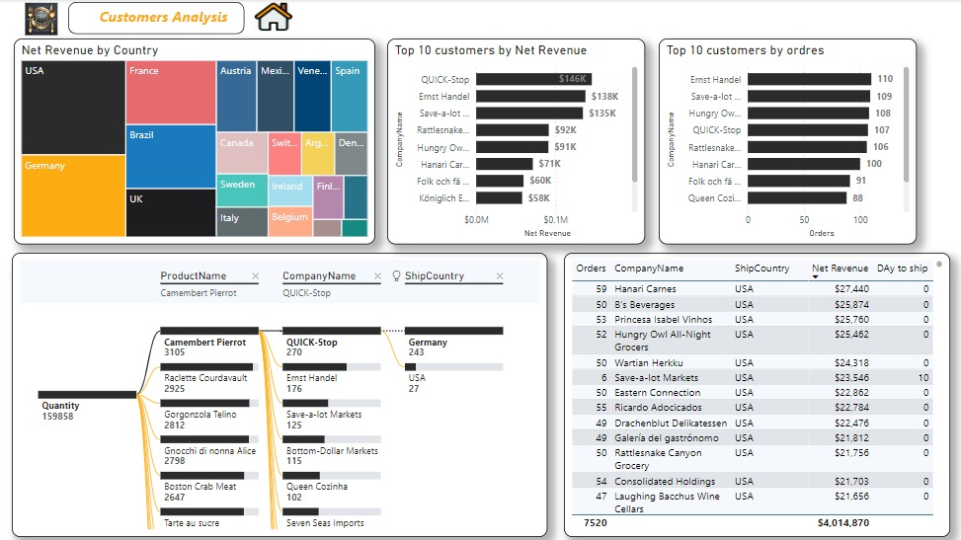

Slide 55
THANK YOU

Slide 56

We’d be happy to hear any feedback or suggestions you might have!

